Slide 1
UTA-VIRT-FSF-PT-01-2020-U-LOL
PROJECT 3
MEREDITH + JARED + COLE + ASHLEY
Notes:
Group 6: PROJECT 3

Slide 2
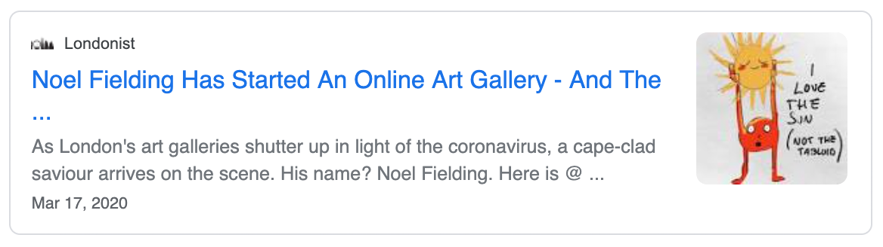
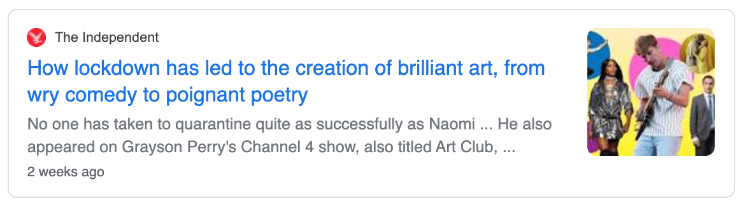
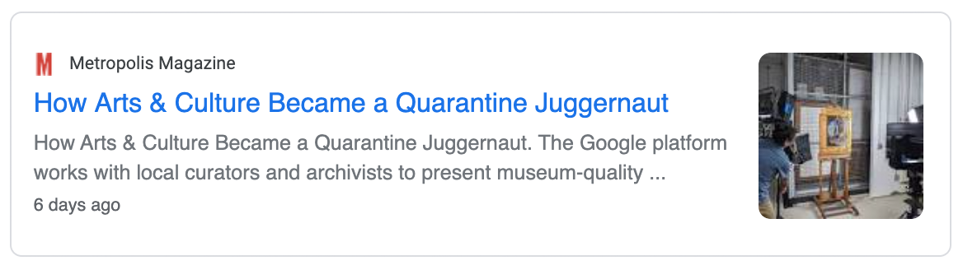
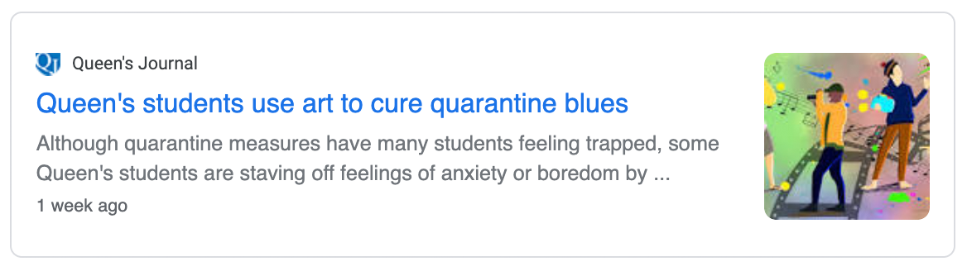
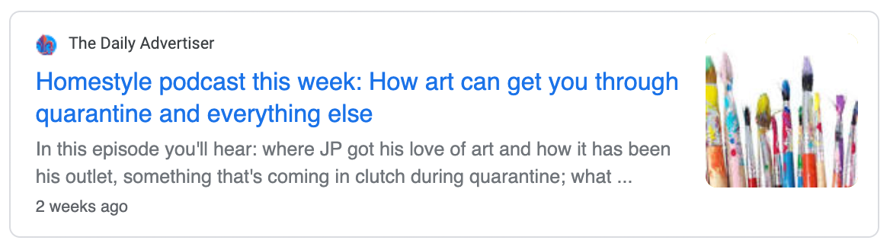
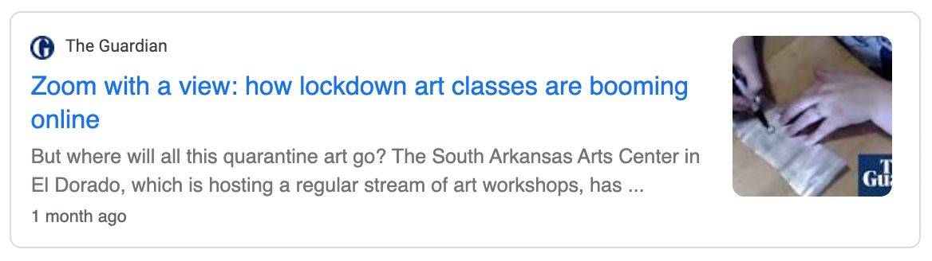
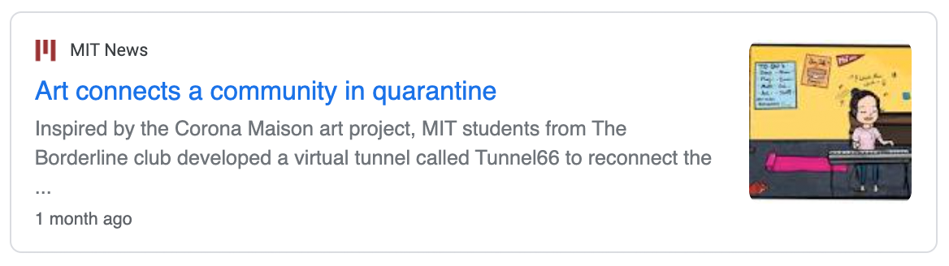
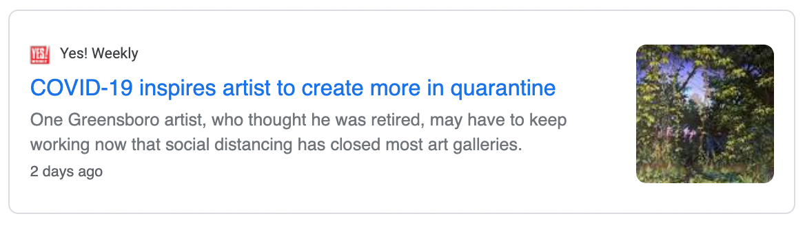
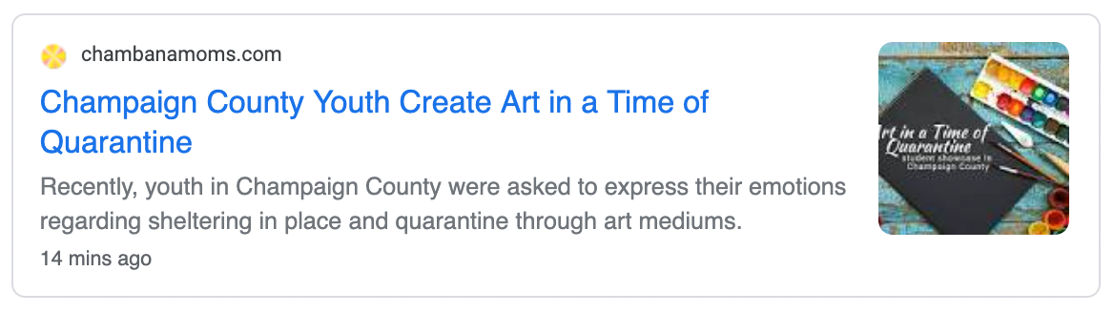
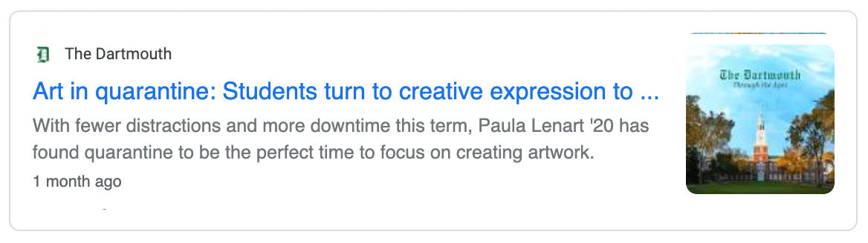
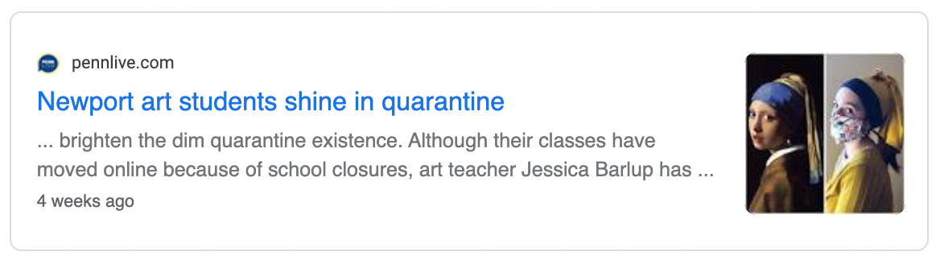
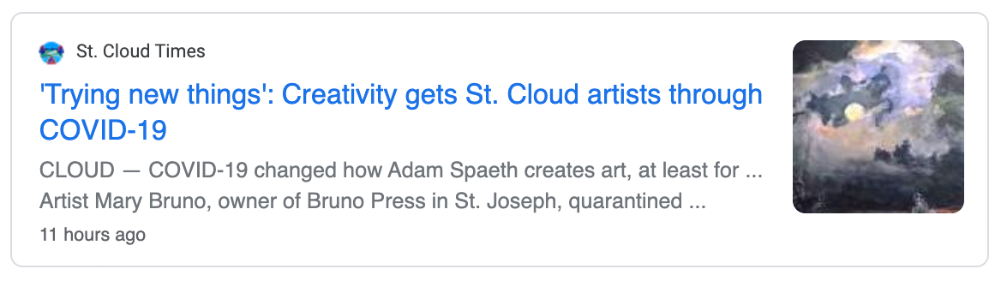
Notes:
An overview of the intended application and WHY you feel it’s valuable:
Recent pandemic headlines demonstrating how art flourished in the midst of quarantine, amongst both novices and established creatives alike.
There are many places online for artists to exhibit and sell their art to the general public (e.g., Instagram, Etsy, Redbubble). However, what we wanted to do was create a community for artists to receive feedback from other artists.

Slide 3
There are many places online for artists to exhibit and sell their art to the general public.
However, what we wanted to do was create a place for artists to receive feedback from other artists.
Notes:
The word salon first appeared in France in 1664
A salon is a gathering of people held by of an inspiring host.
Salons in the tradition of the French literary and philosophical movements of the 17th and 18th centuries were carried on until as recently as the 1920s in urban settings.
Italian invention of the 16th century, which flourished in France throughout the 17th and 18th centuries. The salon continued to flourish in Italy throughout the 19th century.

Slide 4
sa·lon
noun. fashionable gathering of artists, writers, and intellectuals held in a private home.
Notes:
HISTORICAL
The word salon first appeared in France in 1664
A salon is a gathering of people held by of an inspiring host.
Salons in the tradition of the French literary and philosophical movements of the 17th and 18th centuries were carried on until as recently as the 1920s in urban settings.
Italian invention of the 16th century, which flourished in France throughout the 17th and 18th centuries. The salon continued to flourish in Italy throughout the 19th century.
CURRENT
a reception room in a large house.

Slide 5
Notes:
Branding
French artist icon
Friendly typeface with lots of character
Bright, bold, gender neutral color palette
Icons: painting, drawing, writing, music, fashion, photography, digital design, other

Slide 6
Screen Layouts
Notes:
A set of DETAILED screen-by-screen design layouts with annotations describing all UI/UX components and all data relevant to the screen.

Slide 7
Building Process
BACKEND
Meredith & Jared
Database setup and functionality
User authentication setup and functionality
FRONTEND
Ashley & Cole
General design
Page layouts & React components
CSS styling
Notes:
Backend and frontend responsibilities

Slide 8
Technology
FRAMEWORK
MERN STACK
Mongo
Express
React create-react-app
Node.js
NPM PACKAGES
DEPLOYMENT
HEROKU

Slide 9
App Demonstration

Slide 10
Technology
FRAMEWORK
MERN STACK
Mongo
Express
React create-react-app
Node.js
NPM PACKAGES

Slide 11
Challenges
GIT, obvi.

Slide 12
Desired Future Development
TBD
TBD
TBD

Slide 13
Notes:
Branding
French artist icon
Friendly typeface with lots of character
Bright, bold color palette
Icons: painting, drawing, writing, music, fashion, photography, digital design, other

